Slide 1
Exit Strategies
SE495: Software Entrepreneurship

Slide 2
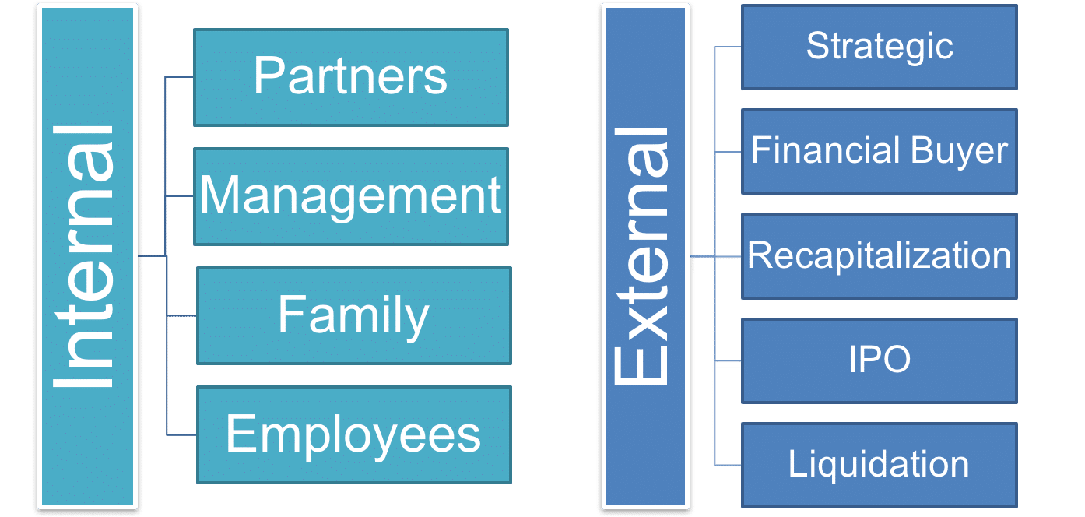
Introduction to Exit Strategies
Exit strategies refer to the plans and strategies devised by startups to sell or transfer their ownership to another entity.
It involves determining how and when the startup will exit the market, either through an acquisition, merger, initial public offering (IPO), or other means of transferring ownership.

Slide 3
Exit Strategies
Maximizing value for shareholders and founders
Providing a clear roadmap
Mitigating risks
Attracting investors and strategic partners
Facilitating succession planning

Slide 4
Types of Exit Strategies
Two common types of exit strategies for startups are:
Acquisition
A larger company acquires the startup.
IPO (Initial Public Offering)
An IPO involves a startup offering shares of its stock to the public for the first time.
Other exit strategies may include:
Merger
Management Buyout (MBO)
Strategic Partnerships or Licensing

Slide 5
Acquisition vs IPO Pathways
Feature | Acquisition | IPO
Goal | To grow by acquiring another company | To raise capital by selling shares of stock to the public
Process | Complex and risky | Challenging but can be rewarding
Outcome | The acquiring company gains control of the acquired company's assets, liabilities, and business operations | The company's stock becomes more liquid and it has the capital it needs to grow

Slide 6
Acquisition vs IPO Pathways
Feature | Acquisition | IPO
Goal | To grow by acquiring another company | To raise capital by selling shares of stock to the public
Process | Complex and risky | Challenging but can be rewarding
Outcome | The acquiring company gains control of the acquired company's assets, liabilities, and business operations | The company's stock becomes more liquid and it has the capital it needs to grow

Slide 7
Acquisition vs IPO Pathways
Acquisition:
Pros:
Higher Valuation
Resources and Expertise
Exit Opportunity
Cons:
Loss of Control
Cultural Integration
Merger Challenges

Slide 8
Acquisition vs IPO Pathways
IPO:
Pros:
Liquidity and Fundraising
Enhanced Visibility and Credibility
M&A Currency
Cons:
Regulatory Compliance
Market Volatility and Investor Scrutiny
Loss of Privacy

Slide 9
Preparing your company for acquisition
Financial Planning:
Accurate and Up-to-Date Financial Statements
Clean Up Financial Records
Financial Projections

Slide 10
Preparing your company for acquisition
Legal Planning:
Compliance with Laws and Regulations
Due Diligence Preparation
Non-disclosure Agreements

Slide 11
Preparing your company for acquisition
Operational Planning:
Streamline Operations
Customer and Employee Retention Plans
Integration Readiness

Slide 12
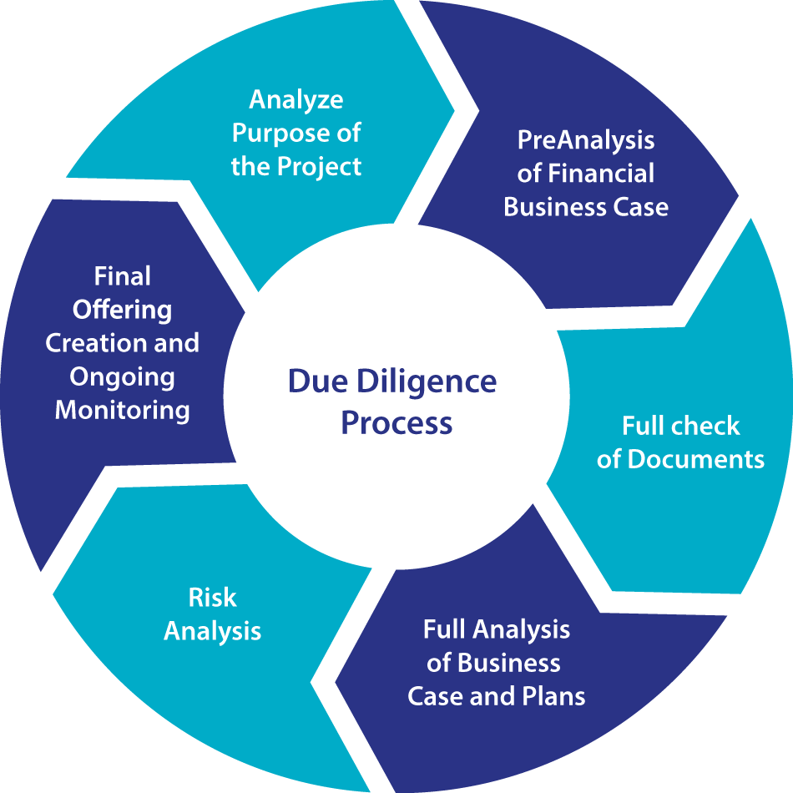
Due Diligence
Due diligence is the comprehensive investigation and analysis conducted by potential buyers or investors to assess the financial, legal, operational, and commercial aspects of a company before a transaction, such as an acquisition or investment, takes place.
It involves a thorough examination of a company's assets, liabilities, financial performance, contracts, legal compliance, intellectual property, customer base, and other relevant factors to identify risks, opportunities, and value drivers.

Slide 13
Due Diligence
Key stakeholders involved in due diligence typically include:
Investors
Lawyers
Financial Advisors

Slide 14
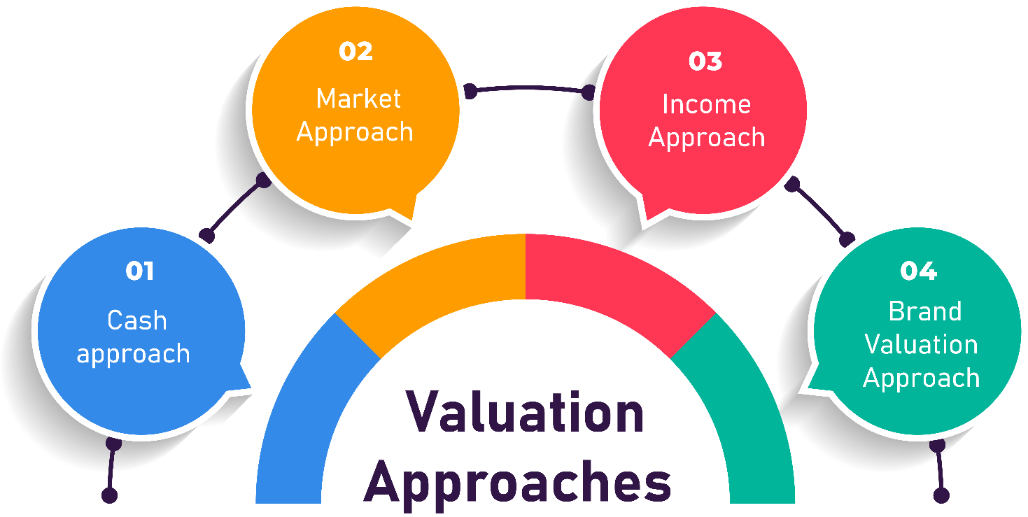
Valuation
Valuation is the process of determining the financial worth or fair value of a company, asset, or investment.
Several methods can be used to estimate the value of a company, including:
Discounted Cash Flow (DCF) Analysis
Comparable Company Analysis
Precedent Transaction Analysis

Slide 15
Valuation
Factors that can impact the valuation of a company include:
Revenue and Profitability
Market Size and Growth Potential
Competitive Landscape
Intellectual Property and Assets
Management Team and Talent
Risk Factors

Slide 16
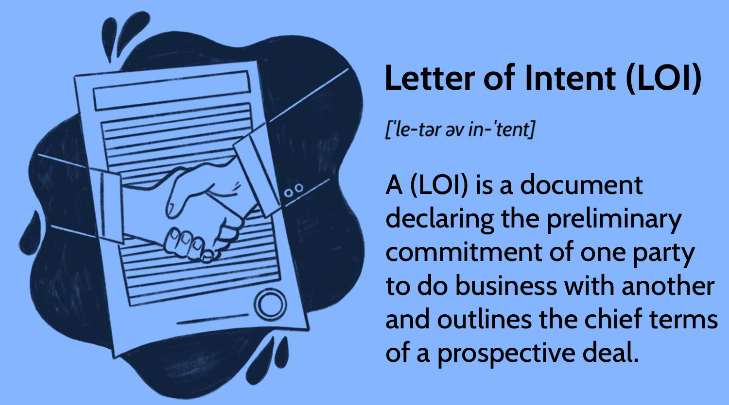
Letter of Intent (LOI)
A Letter of Intent (LOI), also known as a Memorandum of Understanding (MOU), is a non-binding agreement between a buyer and a seller that outlines the key terms and conditions of a proposed acquisition or transaction.
While not legally binding, an LOI serves as a starting point for negotiations and sets the framework for the subsequent definitive agreement.

Slide 17
Letter of Intent (LOI)
Key components typically included in an LOI are:
Price
Payment Terms
Due Diligence Timeline
Closing Date and Conditions
Confidentiality and Exclusivity

Slide 18
Acquisition Agreement
A legally binding contract outlining the terms of an acquisition.
Key components:
Purchase price
payment terms
warranties, and
indemnifications

Slide 19
Post-Acquisition Integration
Challenges: Integration challenges include cultural differences, system integration, and retaining key employees.
Strategies: Strategies for successful integration include effective communication, retention bonuses, and clear goals.

Slide 20
Going Public - IPO Process
An IPO is the process of issuing stock to the public to raise capital.
Key stakeholders: Underwriters, lawyers, accountants, and the company's management team are typically involved in an IPO.

Slide 21
IPO Process
Filing: Filing a registration statement with the SEC, including financial statements and other information.
Roadshow: A presentation by the company's management team to potential investors.
Pricing: Determining the IPO price and allocating shares to investors.

Slide 22
IPO Valuation
Methods: Valuation methods include discounted cash flow, comparable company analysis, and precedent transaction analysis.
Factors: Factors that can impact valuation include revenue, profitability, market size, and growth potential.

Slide 23
Post-IPO Life
Challenges: Challenges include increased regulatory compliance, public scrutiny, and maintaining growth.
Strategies: Strategies for success include effective communication, investor relations, and continued innovation.

Slide 24
Case Studies

Slide 25
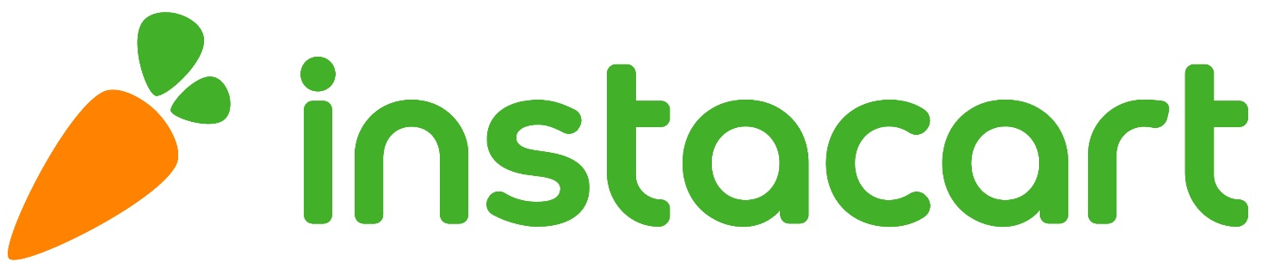
Instacart
Instacart is a grocery delivery and pickup service that was founded in 2012.
The company quickly gained popularity and expanded its operations to multiple cities across the United States.
In 2018, Instacart announced that it had raised $700 million in funding, bringing its valuation to $7.6 billion.

Slide 26
Instacart
In 2020, the company faced a number of challenges, including increased competition from other grocery delivery services, high operational costs, and declining sales.
In response, Instacart's leadership team decided to explore an exit strategy.

Slide 27
Exit Strategy
Instacart's leadership team decided to pursue a strategic acquisition by a larger company.
They identified several potential buyers, including retailers and technology companies, and began negotiations.
In November 2020, Instacart announced that it had agreed to be acquired by Walmart, the world's largest retailer, for $1.5 billion.
The acquisition allowed Instacart to expand its operations and reach a wider customer base, while also providing a return on investment for its shareholders.

Slide 28
Rationale
Instacart's decision to pursue an exit strategy was motivated by several factors.
The company was facing increasing competition from other grocery delivery services, such as AmazonFresh and Shipt, which were offering similar services and gaining market share.
Instacart's operational costs were high, and the company was struggling to achieve profitability.
The company's sales were declining, which made it difficult to sustain its growth and expansion plans.

Slide 29
Rationale
By pursuing an exit strategy, Instacart was able to achieve several objectives.
The acquisition by Walmart provided a return on investment for the company's shareholders, who had invested over $1.8 billion in the company since its founding.
The acquisition allowed Instacart to expand its operations and reach a wider customer base, which would have been difficult to achieve on its own.
The acquisition provided a strategic partnership with a larger company that could help Instacart navigate the challenges of the grocery delivery market.

Slide 30
Conclusion
Instacart's use of an exit strategy is a prime example of how a tech startup can use this tactics to achieve its objectives.
By identifying potential buyers and negotiating a strategic acquisition, Instacart was able to provide a return on investment for its shareholders, expand its operations, and achieve a strategic partnership with a larger company.
This case study highlights the importance of considering an exit strategy as a viable option for tech startups looking to achieve their long-term goals.

Slide 31
Souq.com
Souq.com was a Dubai-based e-commerce platform that was founded in 2005.
The company quickly grew to become one of the largest e-commerce platforms in the Middle East and North Africa, with millions of customers and thousands of sellers on its platform.
In 2017, Souq.com was acquired by Amazon for $580 million, marking one of the largest tech acquisitions in the region's history.

Slide 32
Exit Strategy: Acquisition by Amazon
Souq.com's exit strategy was to be acquired by a larger company, and Amazon was the perfect suitor.
Amazon had been looking to expand its presence in the Middle East and North Africa, and the acquisition of Souq.com provided the company with a ready-made platform and customer base.
For Souq.com, the acquisition provided an opportunity to tap into Amazon's vast resources and expertise, as well as access to a global customer base.

Slide 33
Factors Leading to the Successful Exit
Several factors contributed to Souq.com's successful exit:
Strong Market Position
Innovative Business Model
Strong Financials
Strategic Partnerships
Talented Team

Slide 34
Lessons Learned
Souq.com's successful exit provides several lessons for tech startups looking to follow a similar path:
Focus on Building a Strong Brand
Innovate and Differentiate
Build a Strong Financial Position
Establish Strategic Partnerships
Attract and Retain Talent

Slide 35
Conclusion
Souq.com's successful exit to Amazon is a testament to the company's strong market position, innovative business model, strong financials, strategic partnerships, and talented team.
The acquisition not only provided a successful exit for the company's shareholders but also marked a significant milestone in the growth of e-commerce in the Middle East and North Africa.
The deal also underscores the potential for tech startups in the region to achieve significant growth and success, and serves as an inspiration for other entrepreneurs looking to build and grow their own businesses.
Souq.com's successful exit serves as a reminder that with the right combination of vision, strategy, and execution, tech startups in the Middle East and North Africa can achieve great success and create value for their shareholders, customers, and the wider ecosystem.

